Slide 1
Mood Board

Slide 2
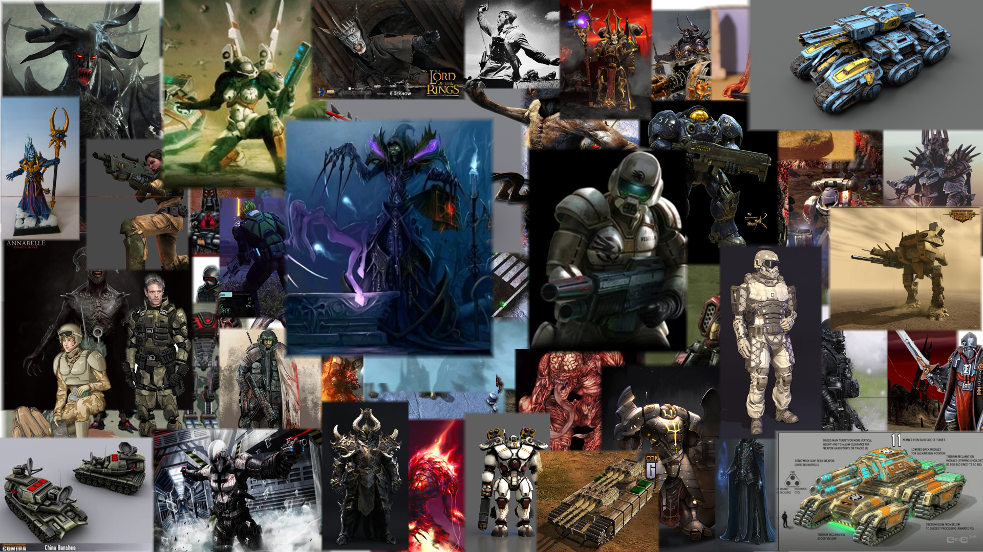

Slide 3
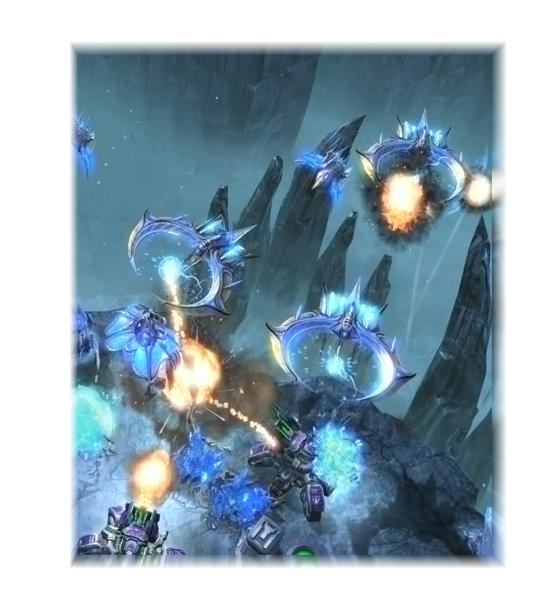
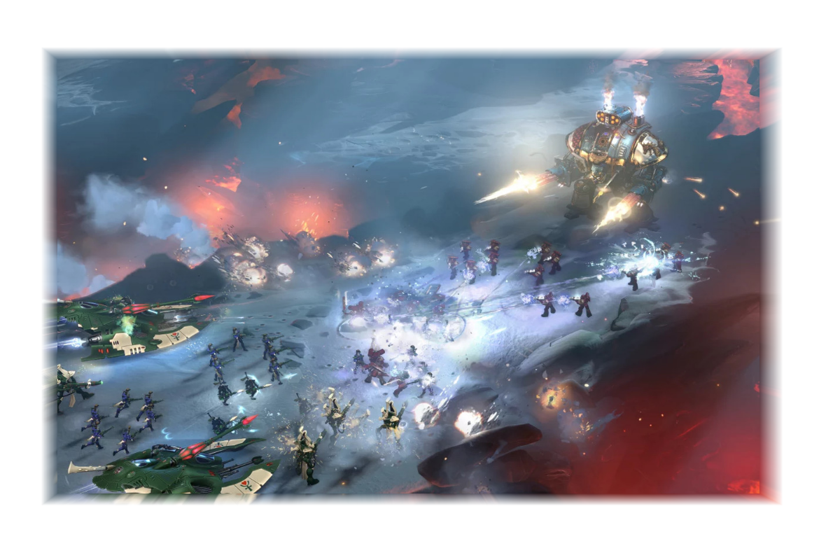

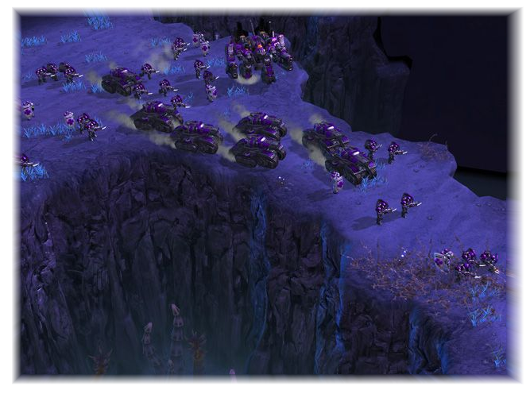

Terrain Overall
I really like the contrast of lava and ice here
Main colours, reds and cold shades
Semi-realistic feel / slightly cartoony with lots of colour saturation
Secondary colours, rocks and vegetation
Deep purples for night time environments
Bright ice colours make the game stand out

Slide 4
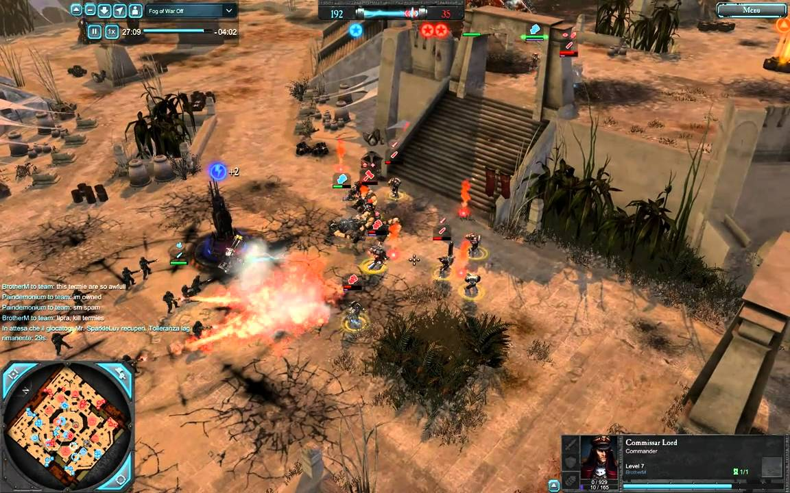
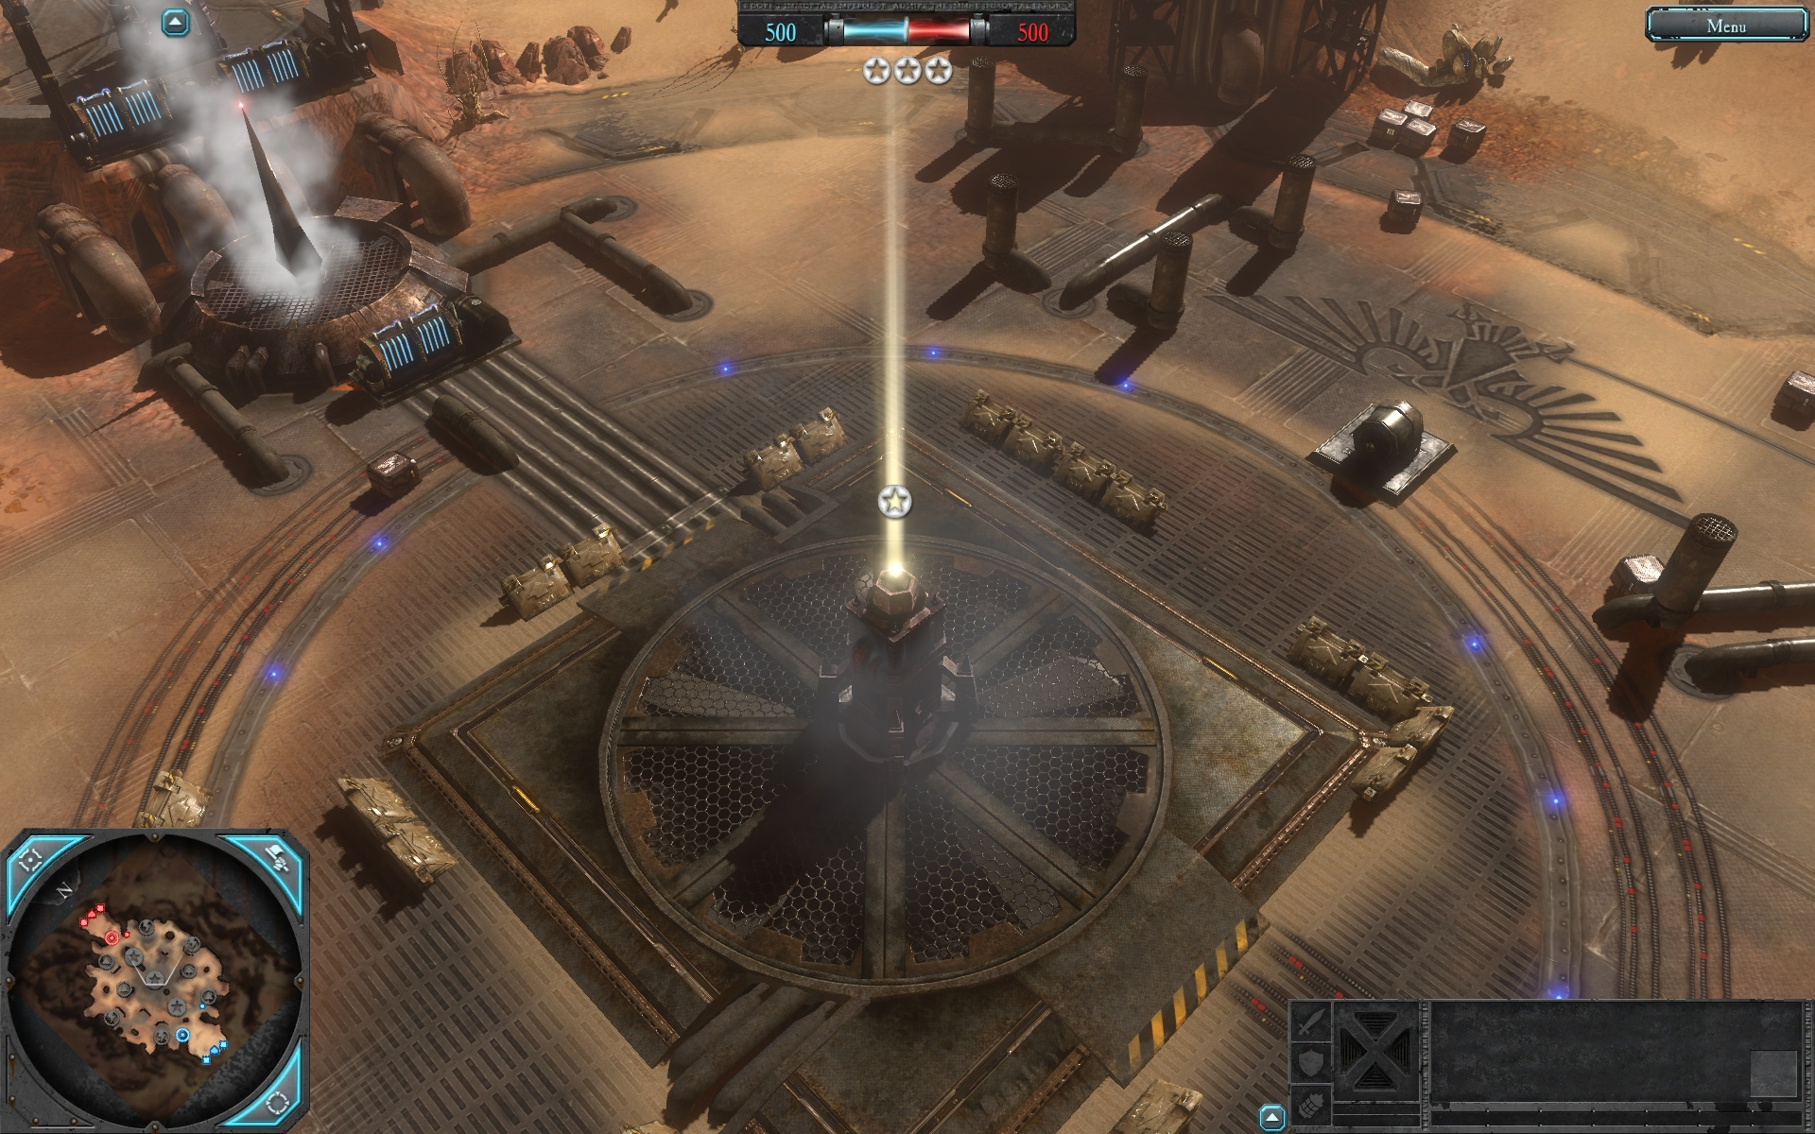
Desert Terrain Overall
Orange sand with contrast to green vegetation
Main colours, reds and cold shades
Semi-realistic feel / slightly cartoony with lots of colour saturation
Decals are important here to break up the similar colours
Steel structures and pipes to create an industrial feel
These missions will look more “realistic” than the tutorial and final mission which take place in a dark and magical area of the world.

Slide 5
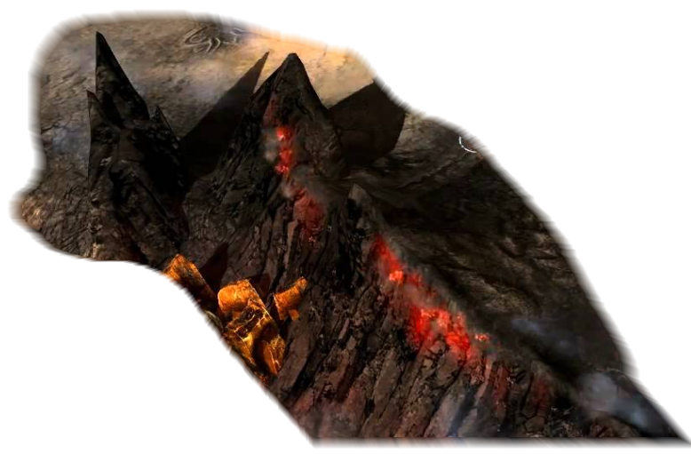
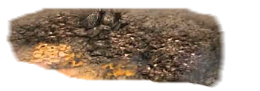
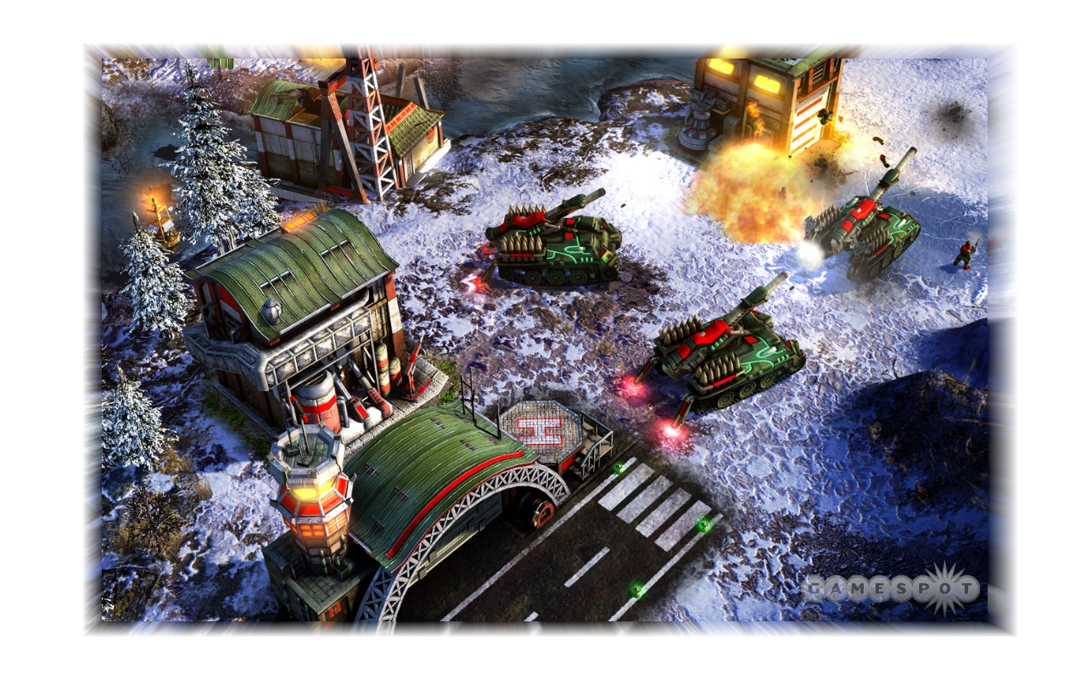
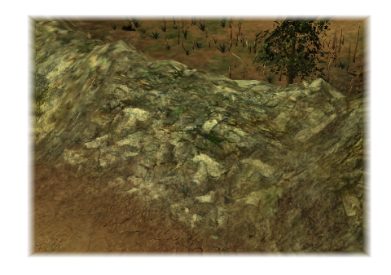
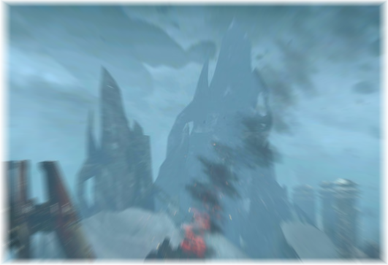
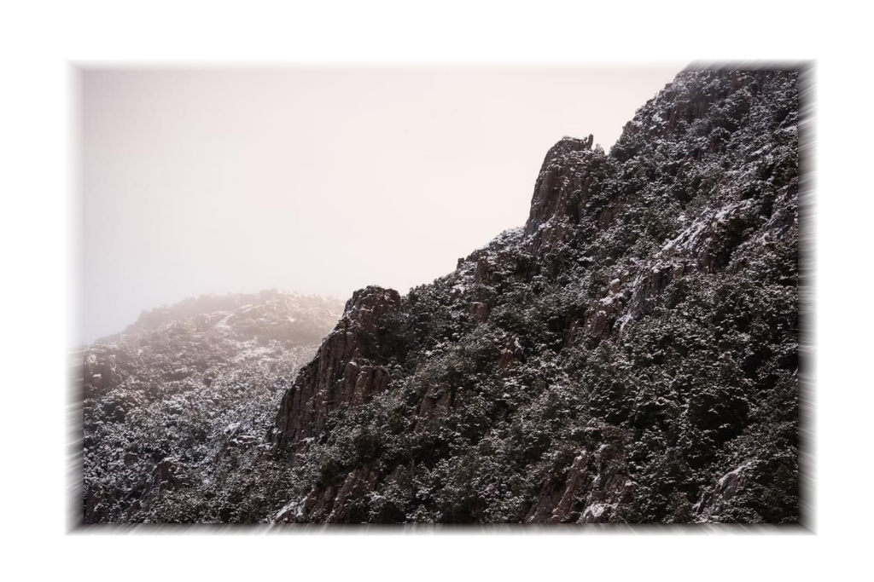
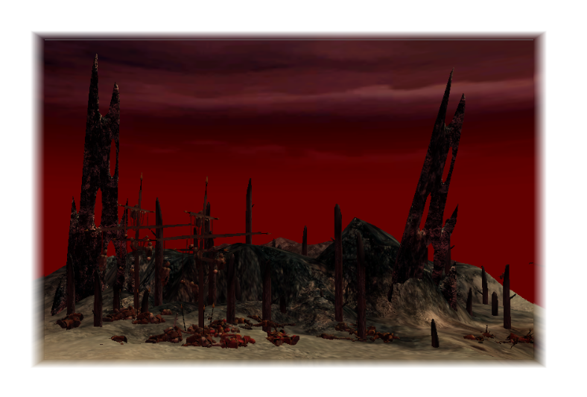
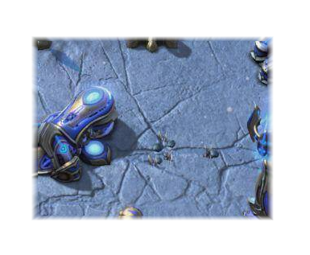
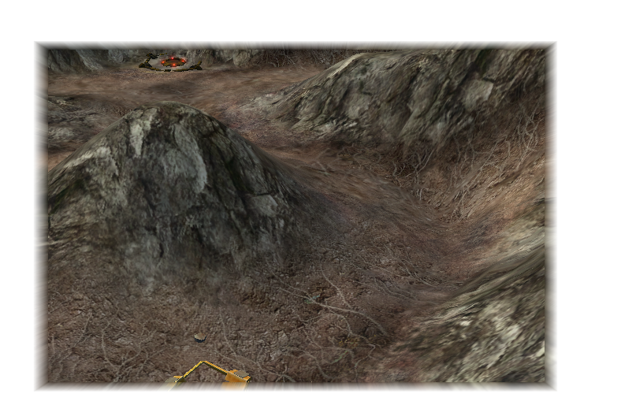
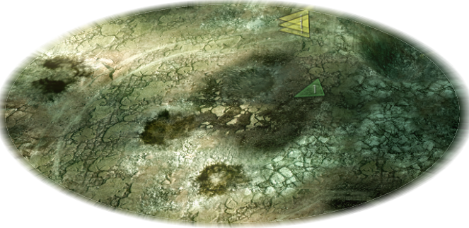
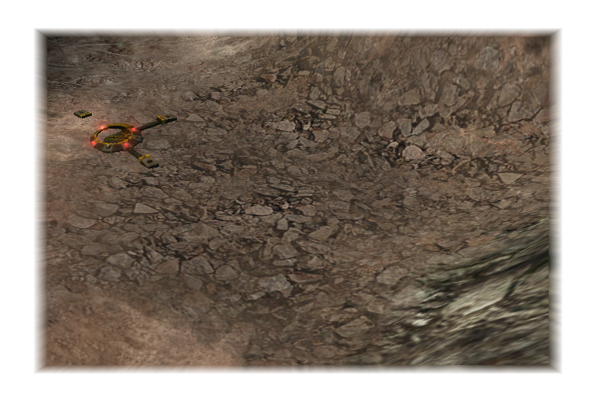
Terrain Detail
Gravely and rocky / icy hills
Unrealistic mountain shapes, tall and spikey. Dark colours with some reds or blues
Cracked, battle scarred and rocky terrain. Layered decals over a neutral colour

Slide 6
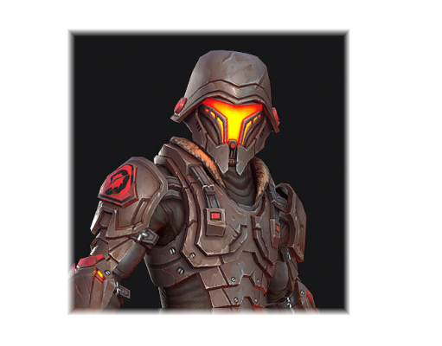
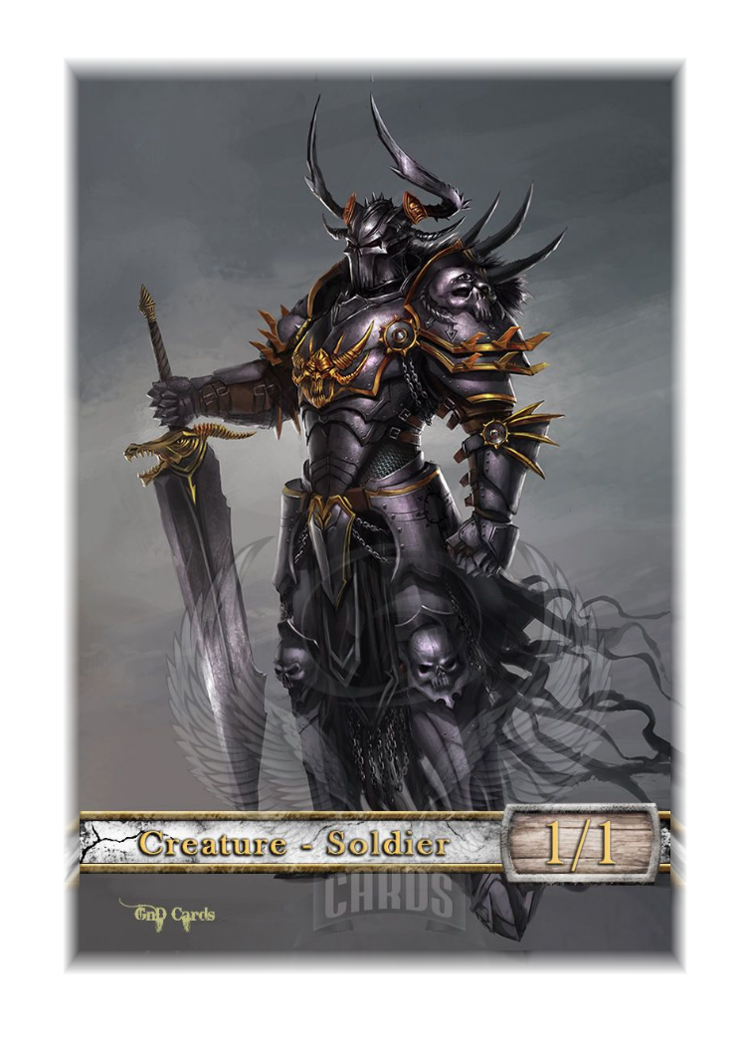
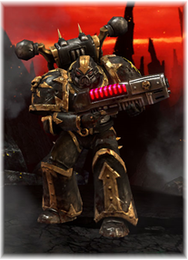
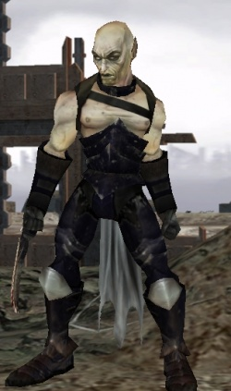
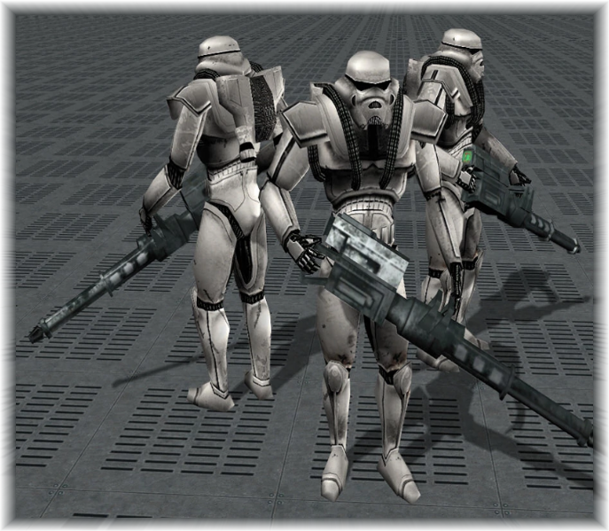
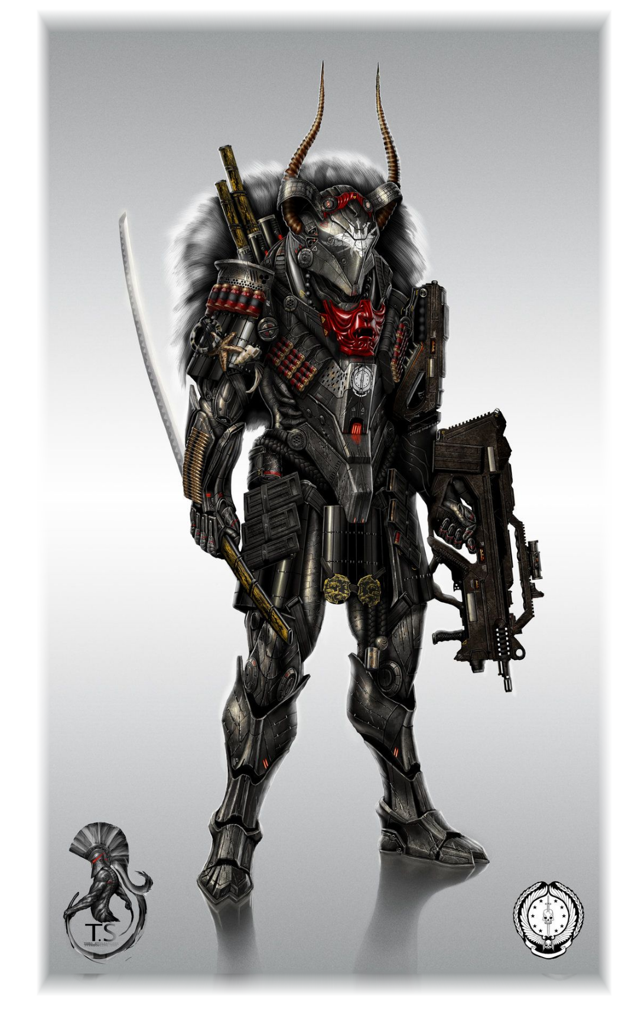
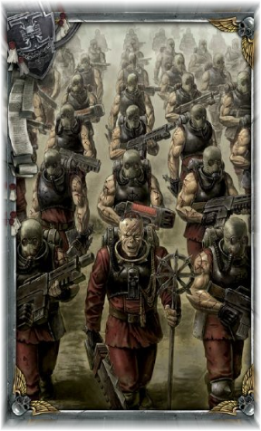
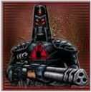
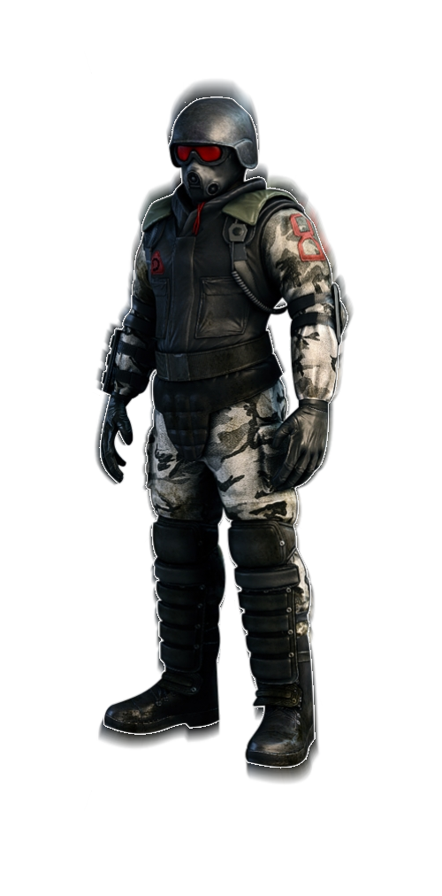
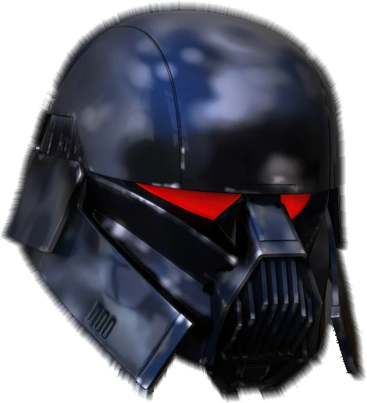


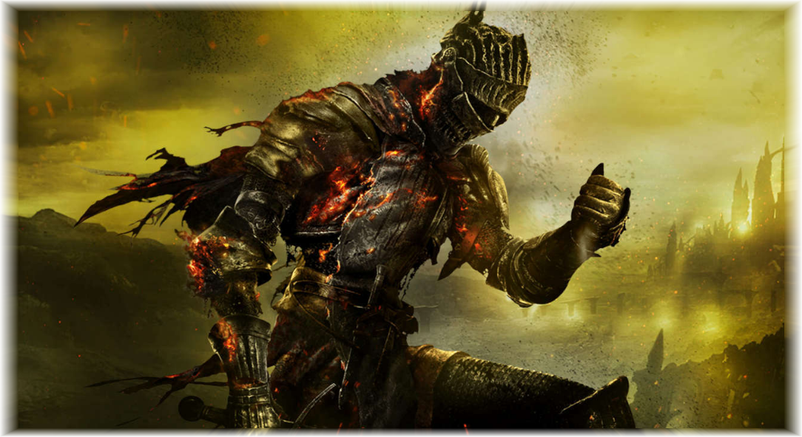
Evil Infantry
LIGHT INFANTRY
Lightly armoured, basic weapons. Variety of colours with metal being dark while clothing having some colour. Metallic with some army clothing. Wearing masks / helmet. Demonic symbols / iconography on some units. Some units sharing similar design to hero light infantry.
HEAVY INFANTRY
Thick bulky armour, somewhat robotic and medieval. Ridiculous heavy weapons. Emphasis on an intimidating helmet design. Fully armoured head to toe and clunky looking. Made from hell, so bright reds and glowing to represent otherworldly powers.

Slide 7
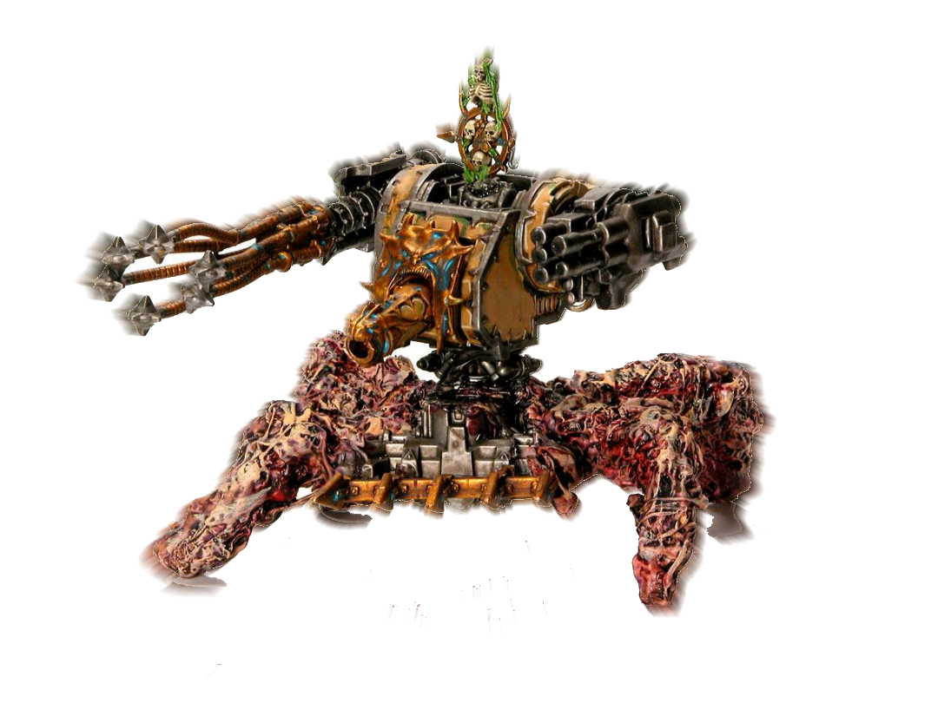
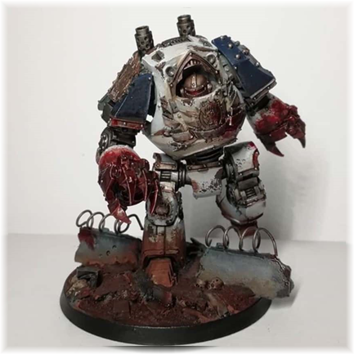
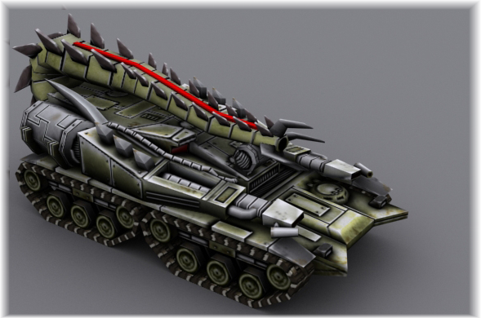
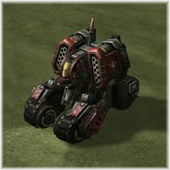
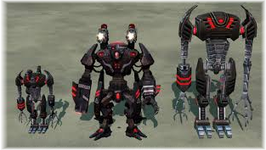

Evil Vehicles
Spikey and bulky. Perhaps infused with demonic entities or flesh. Designed to fit their purpose specifically. Dark metals with blood used as highlights. Bright lights, fire and smoke. Brutal claws and powerful looking weapons.

Slide 8
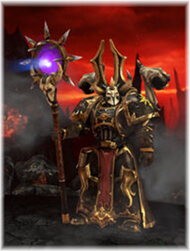
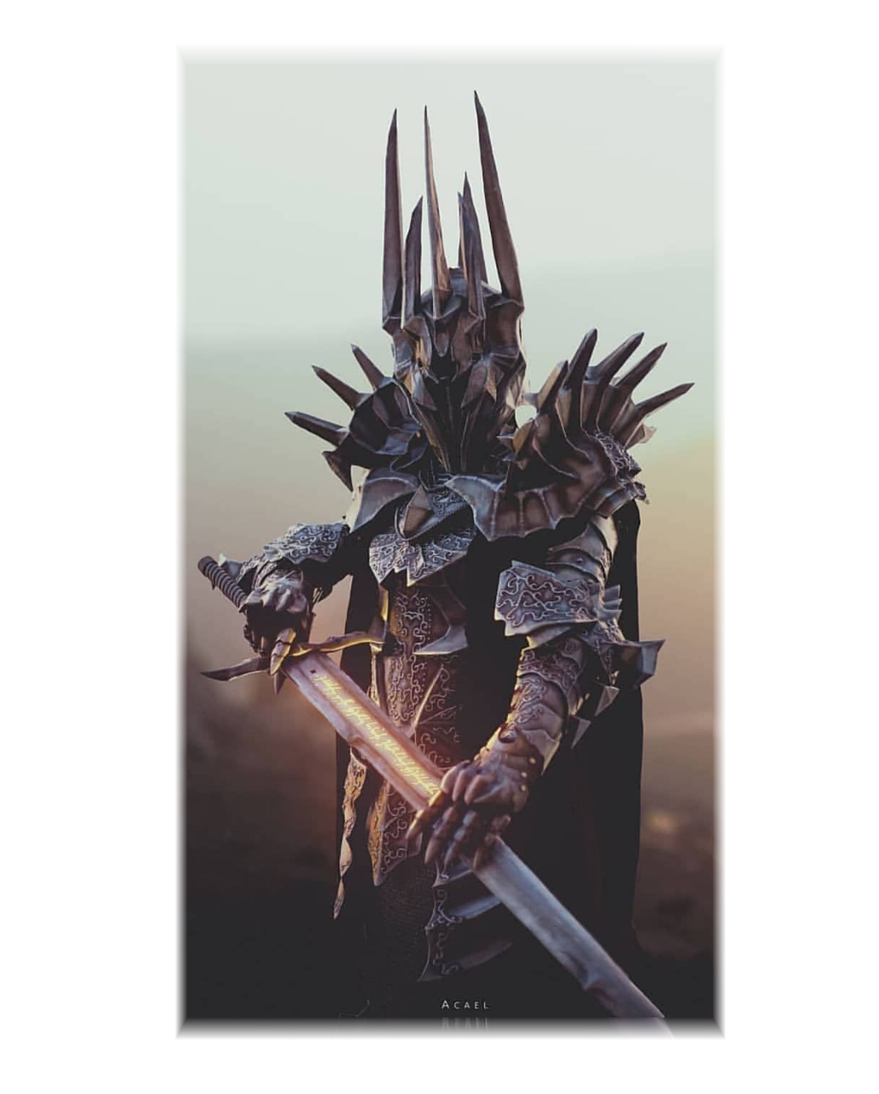
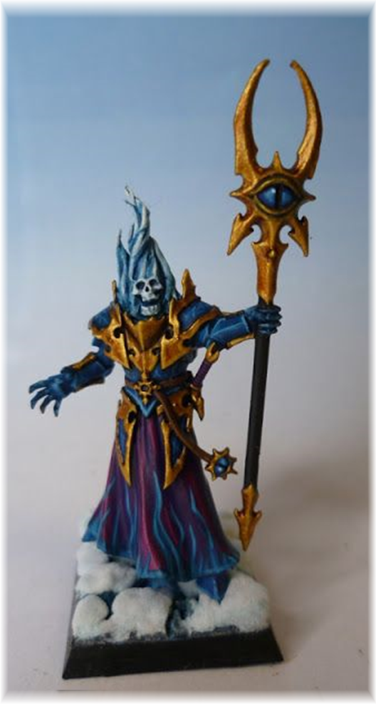
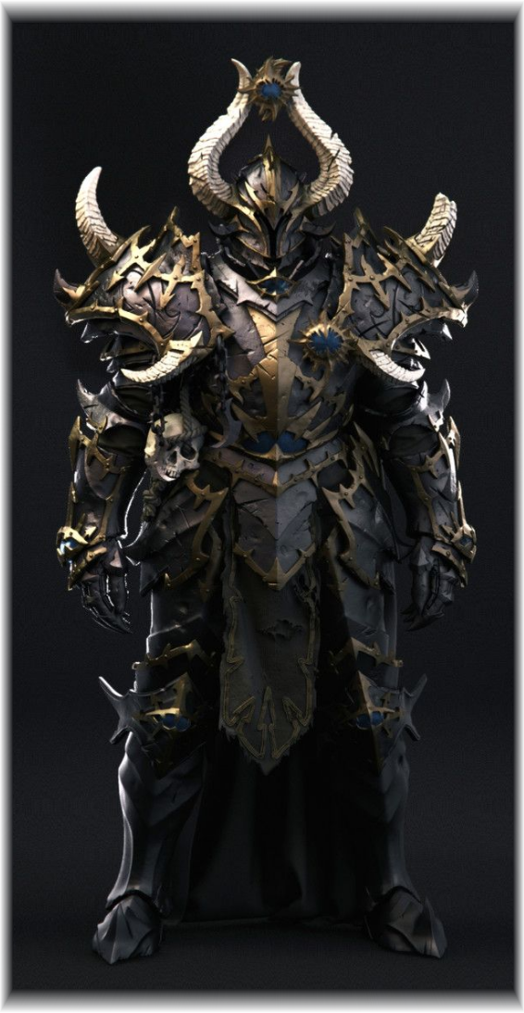
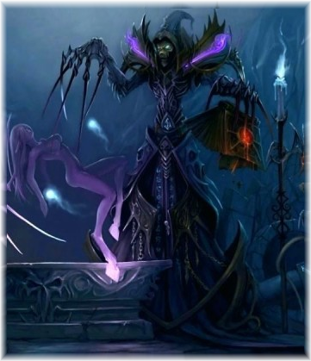
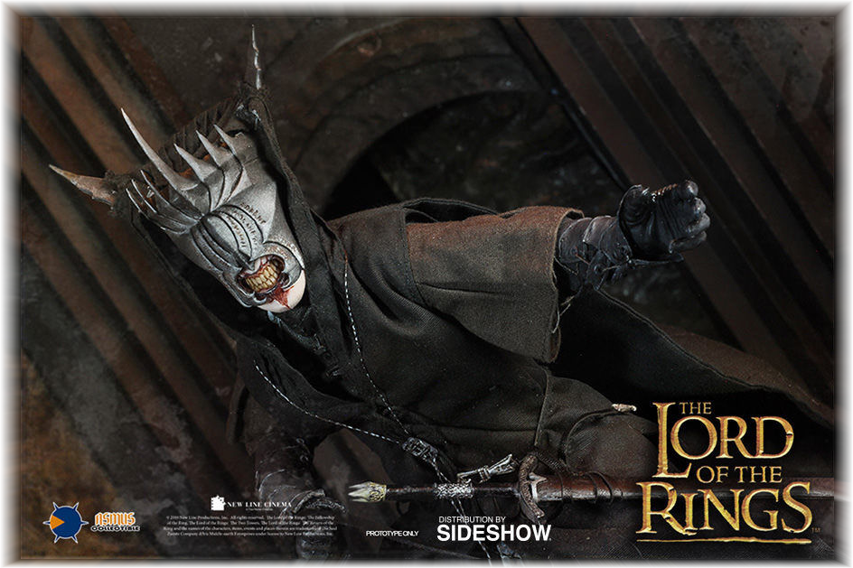
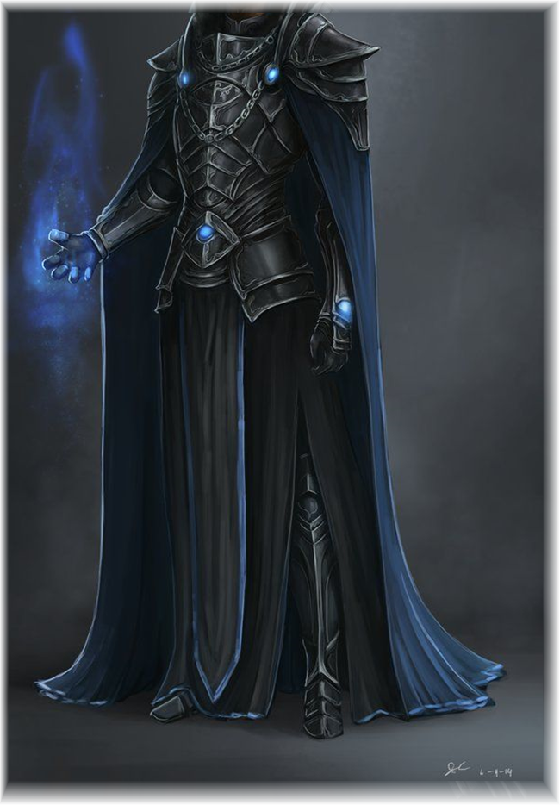
Character – Final Boss “Necromancer”

Slide 9
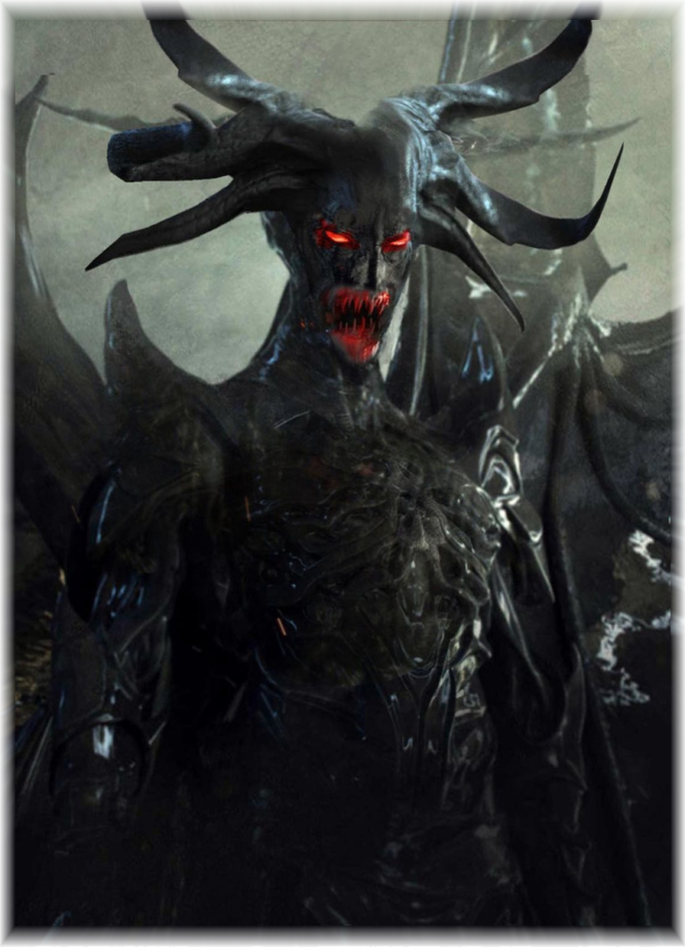
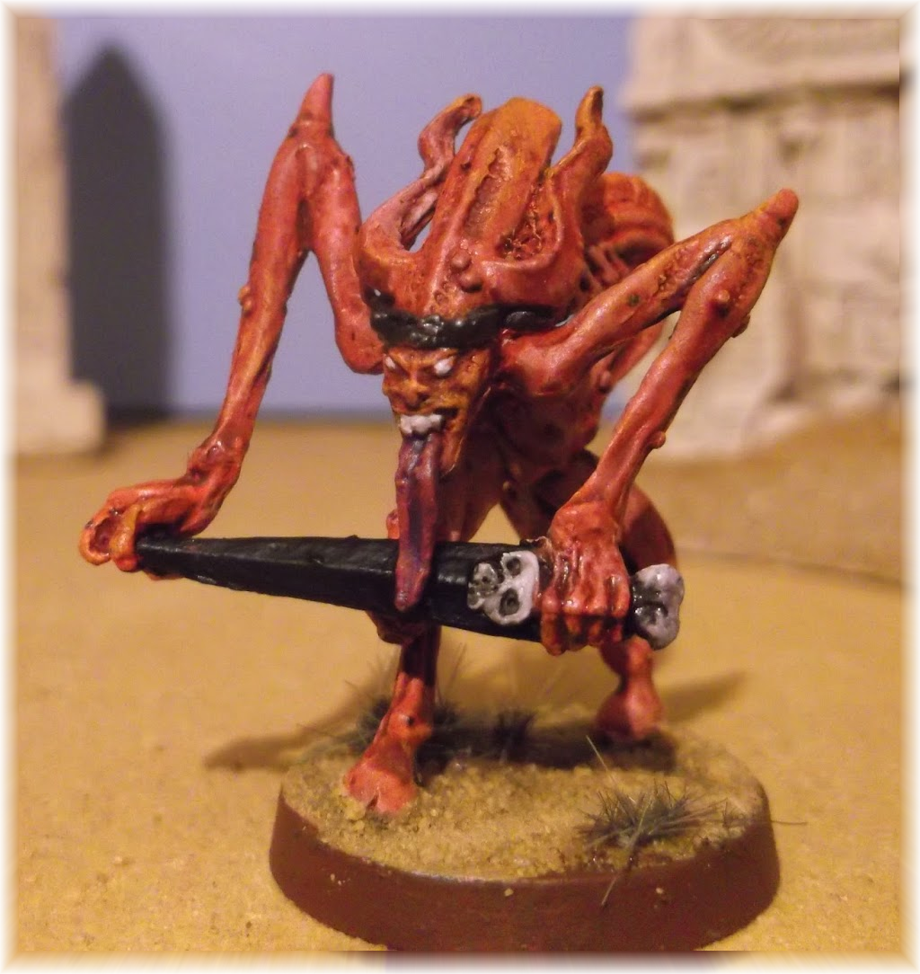
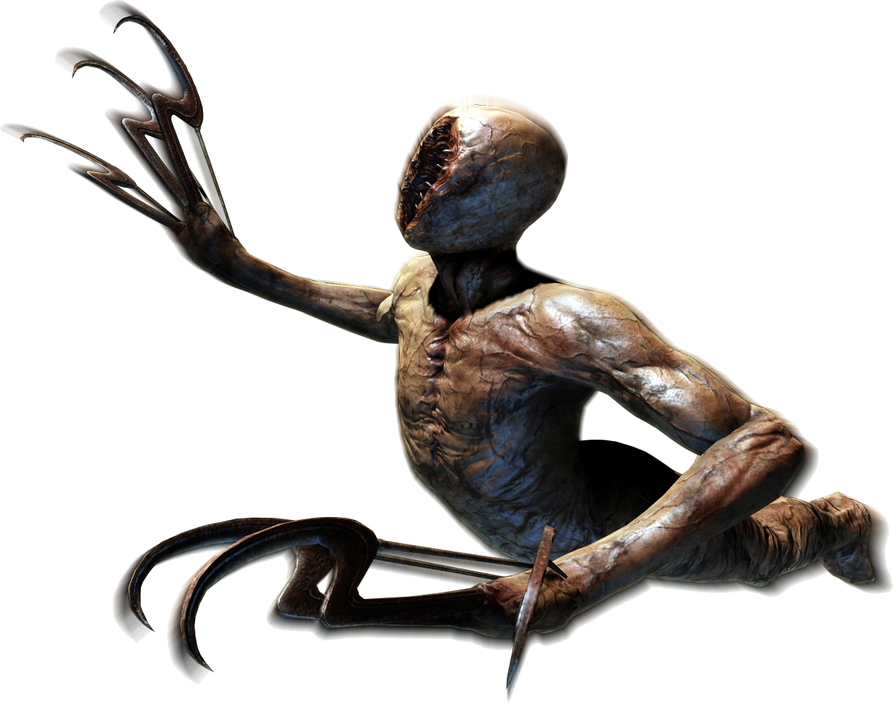

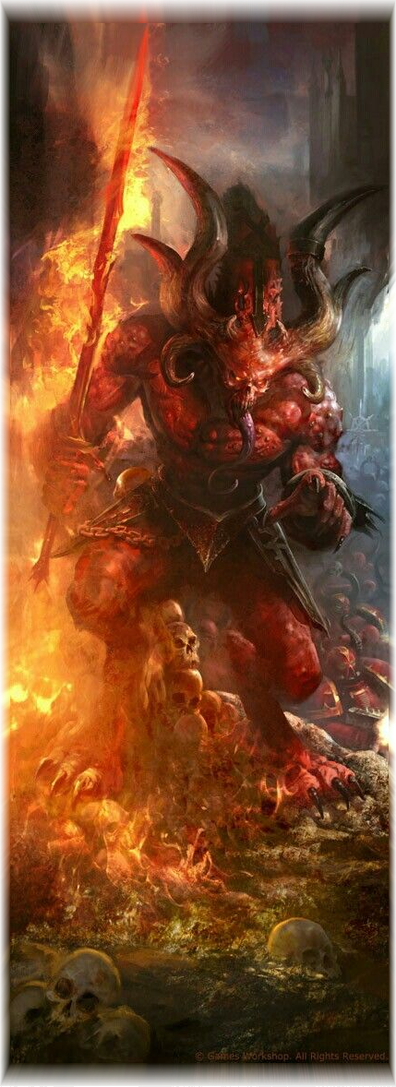
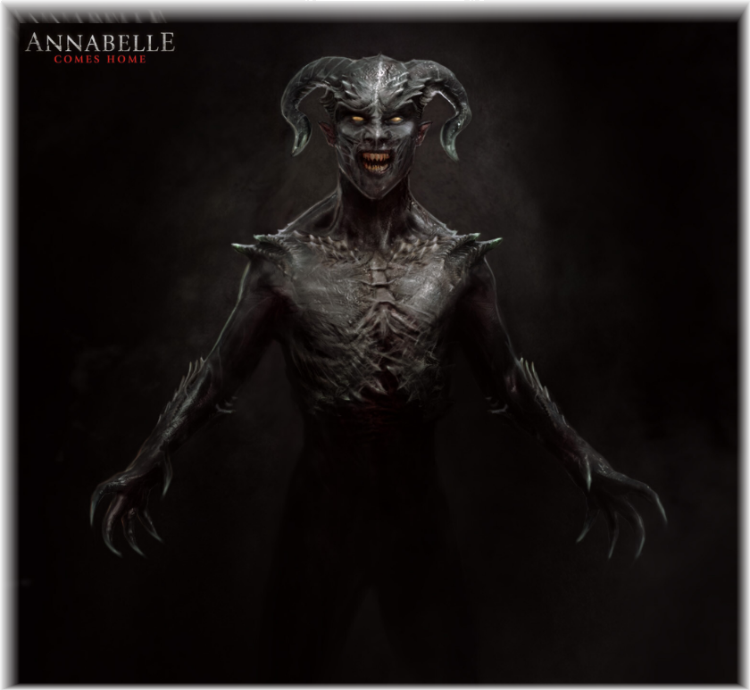
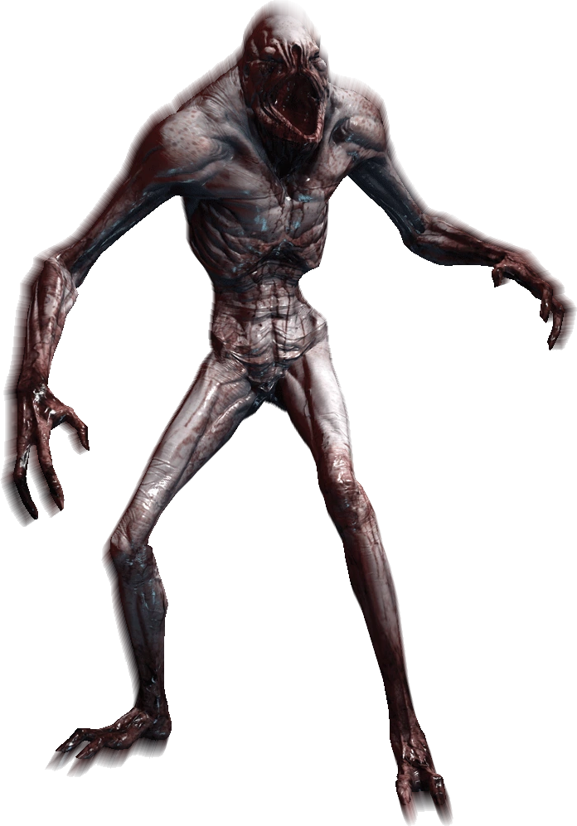
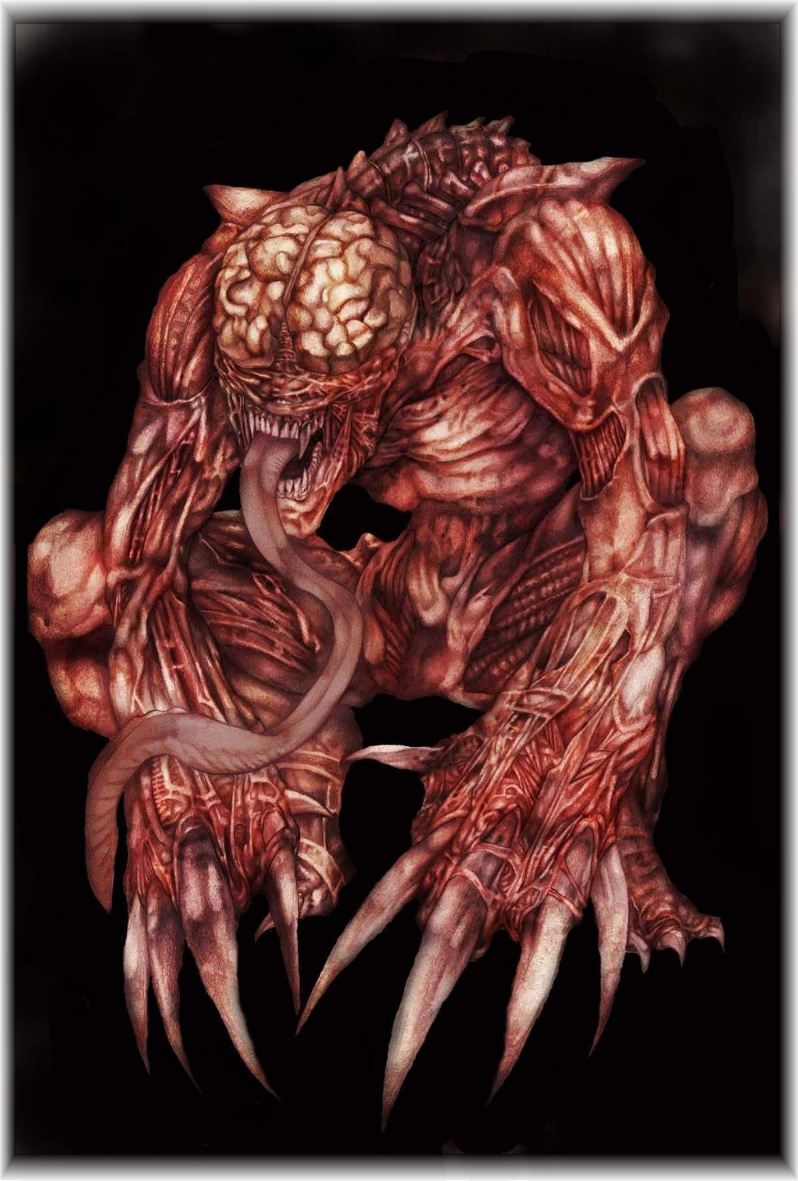
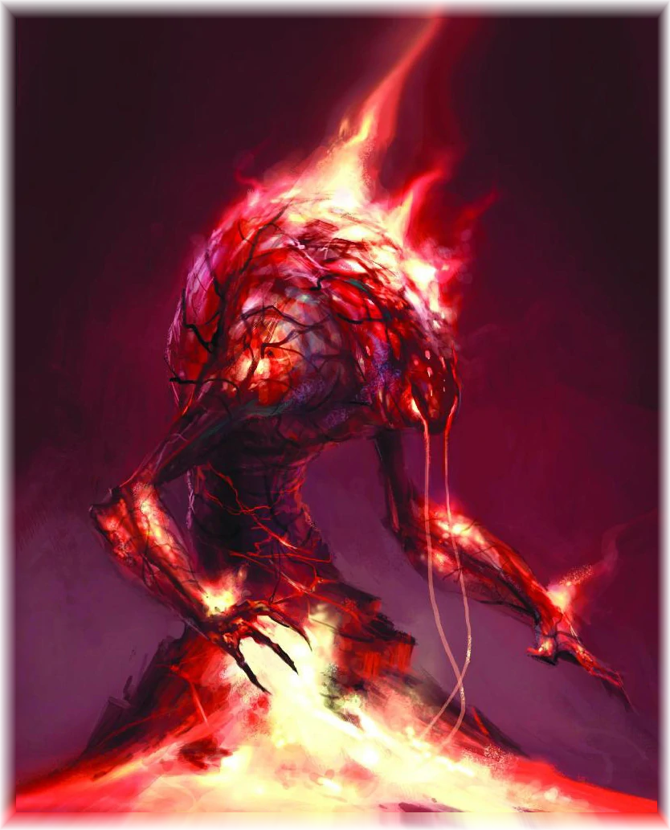
Evil Demons
Demons are used within the evil faction. I want a design that is somewhat humanoid but at the same time looks very foreign and sharp. Disturbing weapons and posture. Covered in magical fire effects to show they have unnatural power, like the evil heavy infantry.

Slide 10
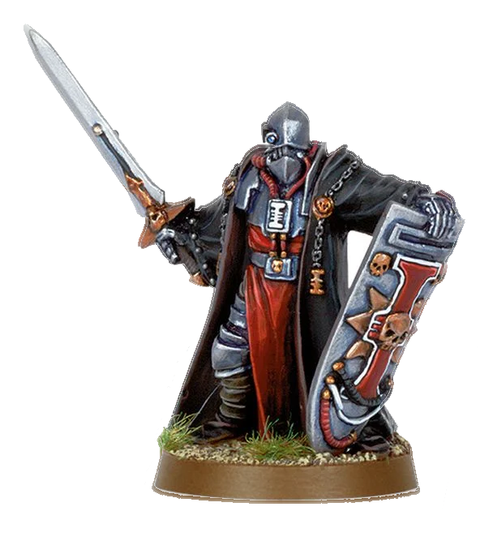
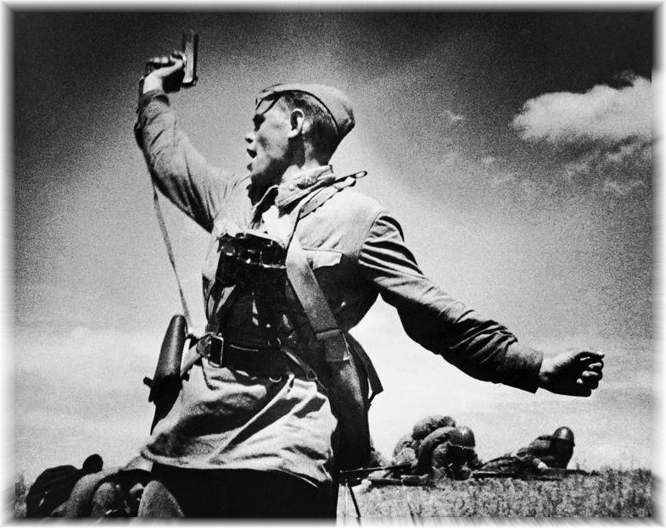











Hero Infantry
LIGHT INFANTRY
Realistic armour, camouflaged colours. Mostly poorly armed. Shades of green and yellow with patterns. Models could be shared through different units with just some new animations.
HEAVY INFANTRY
Advanced, high-tech with large dominating weapons. Heavily armoured but more circular than the villain heavy infantry. Religious iconography on some units perhaps. Bright colour highlights on cold steel metal base.

Slide 11





Character – Hero 1 “Champion”

Slide 12





Character – Hero 2 “Cardinal of War”

Slide 13





Character – Hero 3 “Weapons Specialist”

Slide 14





Character – Hero 4 “Dark Wizard”

Slide 15






Hero Vehicles
Organised, covered in radars and scanning equipment. Loaded with massive barrels and other human weapons. Some vehicles look more put together in quick time using scrap metal, but more powerful vehicles look professional and devastating. Bright colours and painted metal

